Slide 1
Help! For the Helpers.
Implementing RESILIENCE as a Practice
June 2020
WELS Commission on Luther Schools Mentor Program
Karen Fischer, LPC
Notes:
Or as I like to call it…

Slide 2
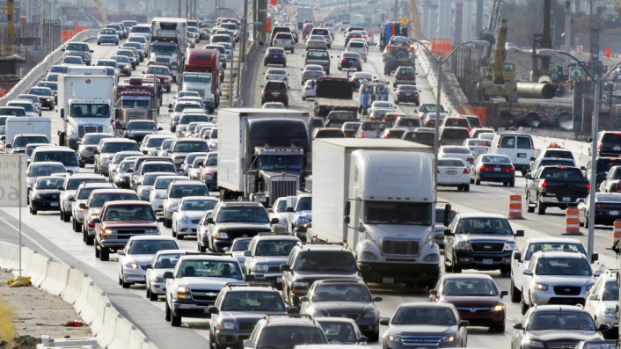
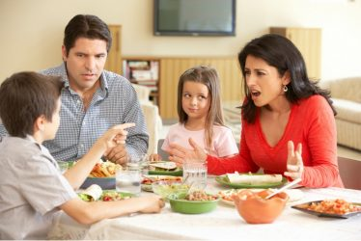
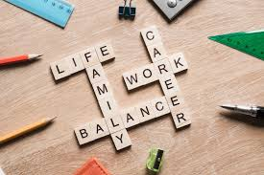
The Lay of the Land - THEN

Slide 3
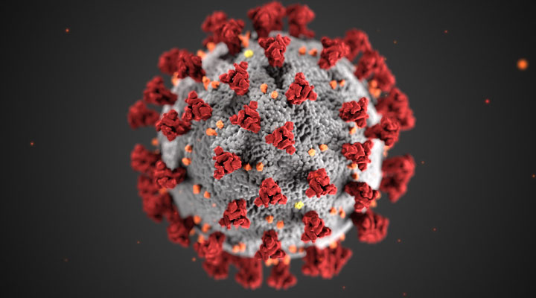
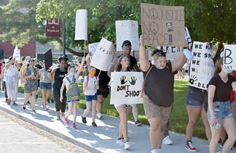
The Lay of the Land - NOW

Slide 4
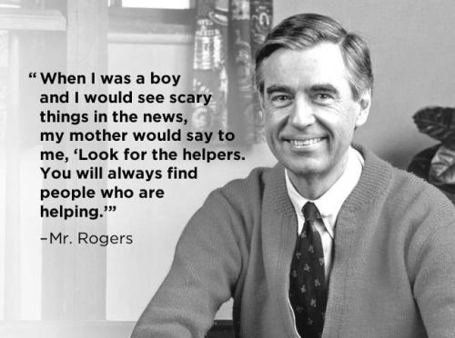

Slide 5
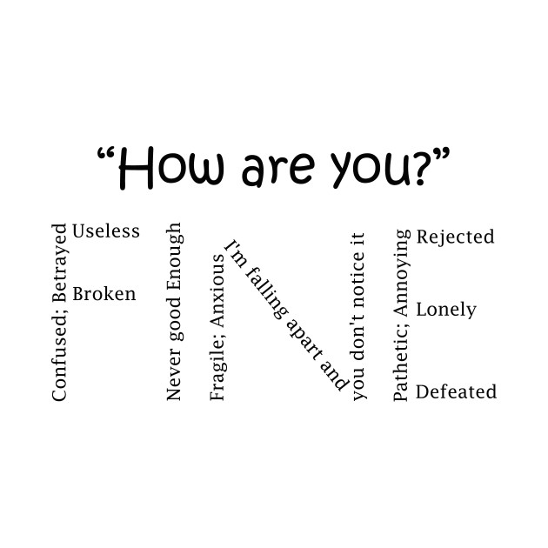

Slide 6
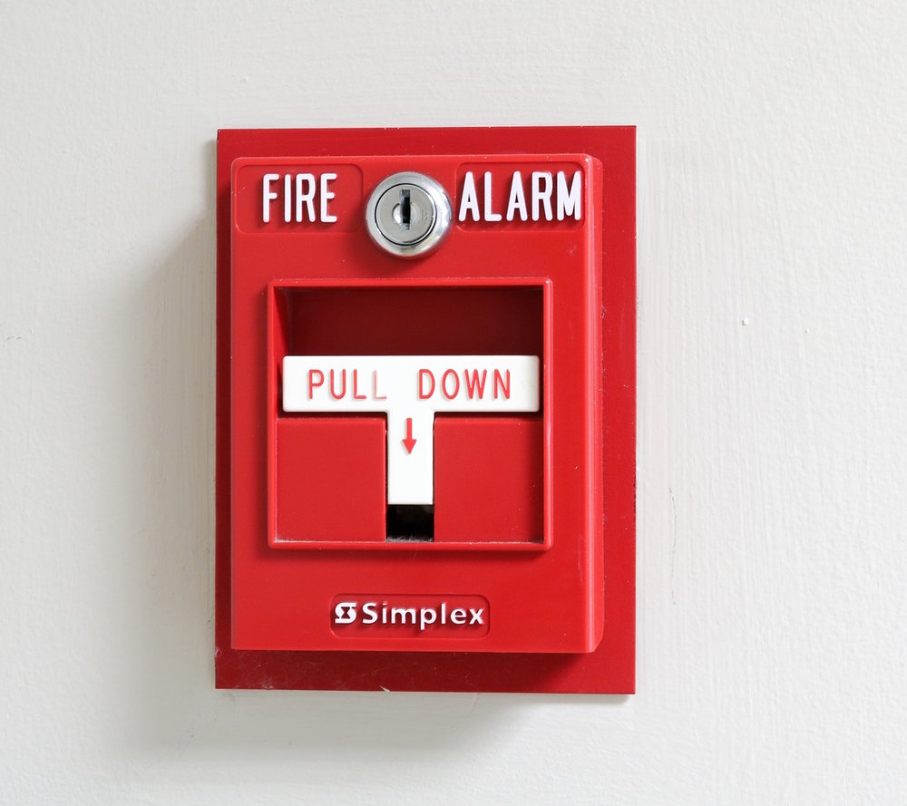
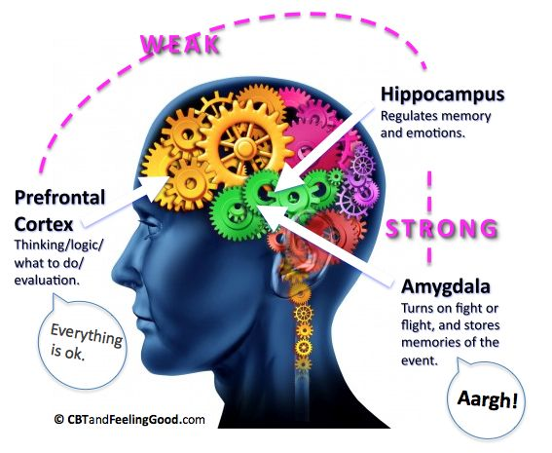

Slide 7
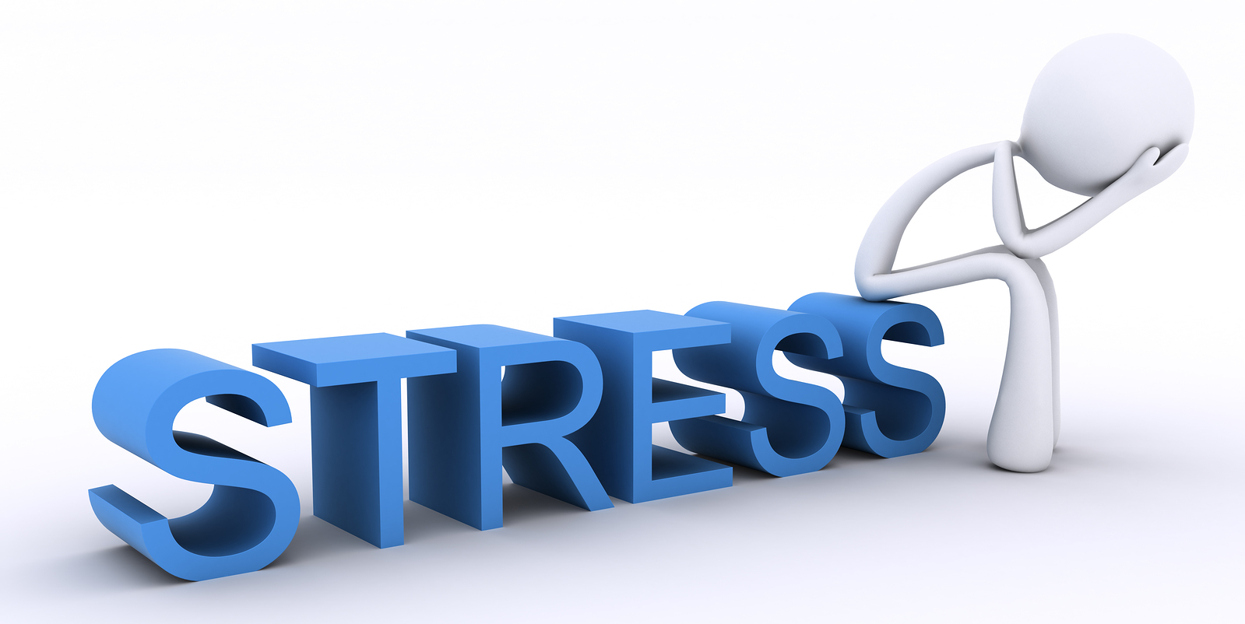
4 Possible Responses to Crisis
Solve
Survive
Accept
Adapt
(Stay Miserable)

Slide 8
GRIEF PROCESS Tasks
T ruly accept the loss has occurred
E xperience the pain of the loss
A djust to the new environment
R einvest in the new reality

Slide 9
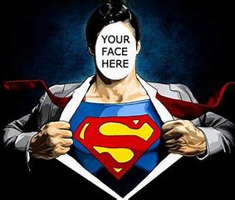
Be A “CAPTAIN BOUNCE BACK” able to overcome difficulty in a single thought reframing
Explore the reasons for RESILIENCE
Understand characteristics of RESILIENCE
Identify RESILIENCE in self and others
Incorporate RESILIENCE practice for yourself
Notes:
Review Objectives
On the white board – each of you think about a person you would define as “resilient – a captain bounce back type” and list a characteristic you think they possess that makes them fit that description.
Who will share with the group – the characteristic they wrote and why they think that makes their person resilient?

Slide 10
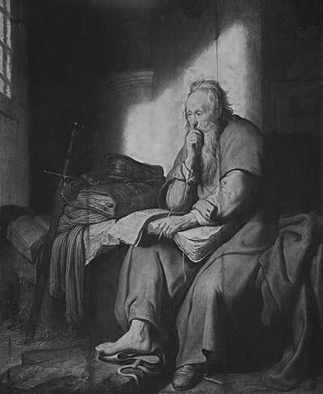
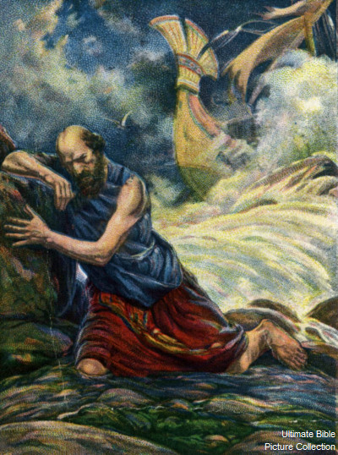
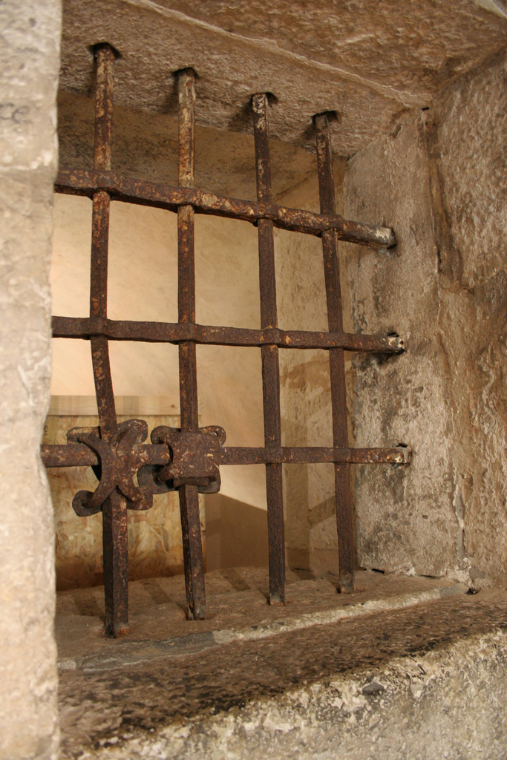
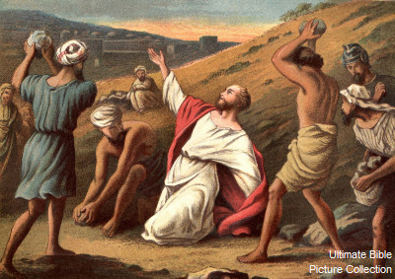
Paul was a “Captain Bounceback”
Paul had some difficulties: Thorn in the flesh, Shipwrecked, Imprisoned, Beaten, Stoned, Endangered. 2 Corinthians 11:22-31 and 12:7-10

Slide 11
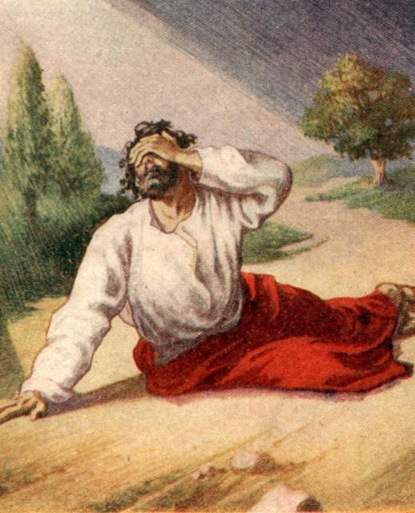
Paul was a “Captain Bounceback”
Ultimately, because Jesus called him, he bounced back. Not from his self reliance but because of his resilience in Christ. Acts Ch. 9

Slide 12
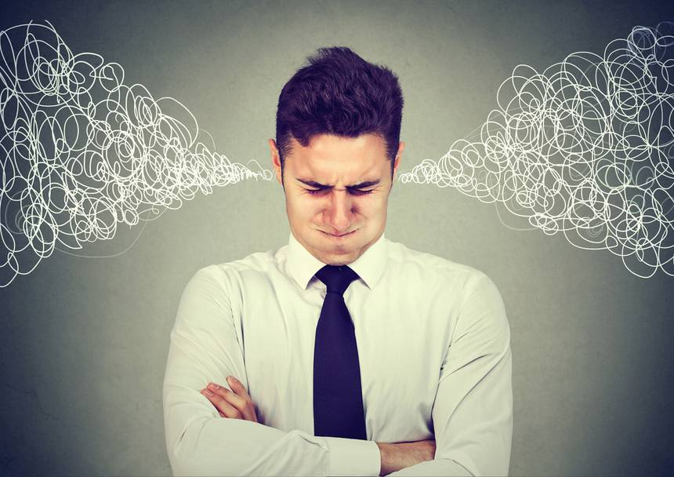
Top Stressors
#1 - Finances
#2 - Family and Relationships
#3 - Job Stability
#4 - Fast Pace of Life
#5 - Health

Slide 13
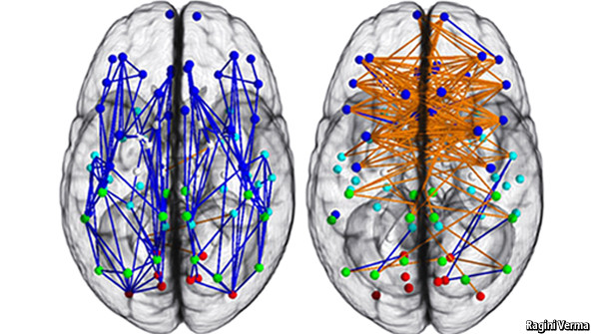
TOP STRESS RESPONSES
Looking to synthesize and reduce complications
Silent and thoughtful
Lowered response to others’ emotion
Focused thought toward decision
Looking to understand
Increased verbalization
Use of senses to take input from others
High coordination between hemispheres

Slide 14
ElEMENTS OF RESILIENCE ~ Susan Kobasa
Challenge
Commitment
Personal Control
Resilient individuals view a difficulty as a challenge, not a paralyzing event. They see mistakes as lessons to be learned from and opportunities for growth. Difficulties have no negative reflection on their ability or worth.
Resilient individuals commit to life and daily goals and are compelled to live life accordingly. They are committed despite feelings about those commitments.
Resilient individuals spend time and energy on situations that can be influenced, which increases confidence. They spend no time worrying about uncontrollable events, which reduces helplessness.

Slide 15
View OF Setbacks ~ Martin Seligman
Permanence
Pervasiveness
Personalization
Resilient individuals see the effects of bad events as temporary rather than permanent. They expect that the difficulties of this time will resolve or be handled in such a way that they will not continue to affect one negatively.
Resilient individuals deal with setbacks or bad events in relation to that part of their daily life. They are unwilling to let a difficulty in one area affect other unrelated areas.
Resilient individuals do not exclusively blame themselves when external negative events occur. They ensure that the full picture of how causes interact is considered.

Slide 16
LEARNED ATTRIBUTES ~ Cal Crow
Positive Image of the Future
Empathy & Compassion
Lack of Victim Mentality
Resilient individuals envision brighter days ahead and see past the difficulty of the present. They harness their ability to look over what is current and to paint a picture of what will be.
Resilient individuals do not waste time worrying what others think of them. They feel for others but not with them. They encourage and support but do not bow to peer pressure and they enforce limits and boundaries.
Resilient individuals discern the difference between being a victim and being victimized. They focus time and energy on changing things that they have control over and letting go of those they do not.

Slide 17
IDENTIFYING RESILIENCE
My 2 Strongest Resilience Characteristics Are…
My 2 Growth Resilience Characteristics Are…
Challenge
Commitment
Personal Control
Permanence
Pervasiveness
Personalization
Positive Image of the Future
Empathy & Compassion
Lack of Victim Mentality
Challenge
Commitment
Personal Control
Permanence
Pervasiveness
Personalization
Positive Image of the Future
Empathy & Compassion
Lack of Victim Mentality
Notes:
To yourself – think about each of the characteristics – look back at your notes and choose two that you feel you are good at as well as two you could improve upon and check those.
Got ‘em? Now the planning part…

Slide 18
INCORPORATING RESILIENCE
I increase my strength in the ________________ characteristic by …
I increase my growth in the ________________ characteristic by …
_Pervasiveness_________________:
Notice when I am trying to be present in one situation but am thinking about a different one.
Eg. Instead of laying in bed at night and thinking about a problem for tomorrow that I can do nothing about right now I can pray about it and let it go.
__Commitment___________:
Get it through my head by repeating the thought that feeling like doing something has nothing to do with actually following through with it.
Eg. Schedule workouts in my calendar and change my clothes for the gym before I leave work so I don’t have to deal with not feeling like going.
Notes:
Now we ant to pair up with a person who has one of the same strengths as you See if you can find someone with one of your top two – go…
Talk with each other about why you chose this – what particular ways you think you are gifted with this strength ways you tend to think or act that demonstrate this. Then talk about actions you could take to further improve or bolster that skill or ways you could demonstrate it in front of or to others.
Now take your 2nd strength and do the same for yourself – consider how you are gifted with this and how you would grow or share it
FLIP FLOP
Pair up with a person who has one of your growth areas. Same thing – where do I struggle with this or what are my challenging thoughts and behaviors and then what is a concrete thing I could do to improve it.

Slide 19
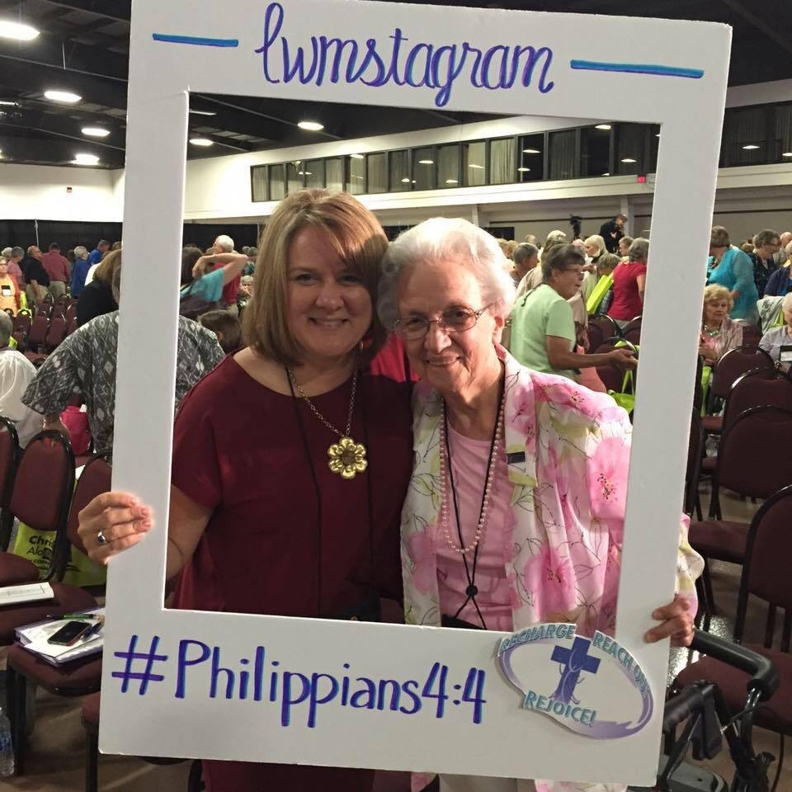
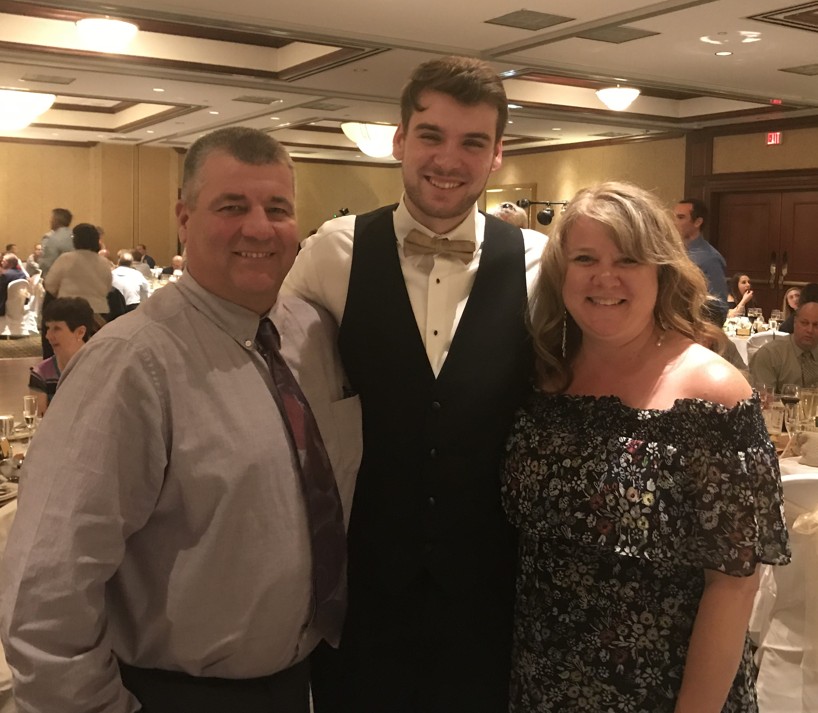
APPRECIATE RESILIENCE
Proverbs 22:6
Train up a child…

